Slide 1
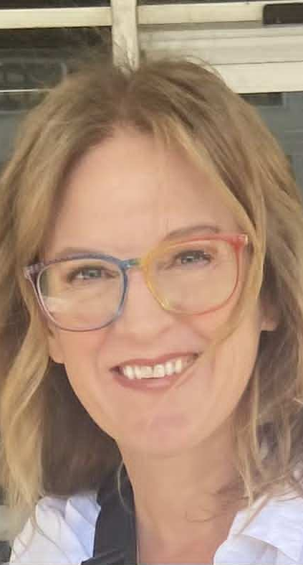

What You Know That You Don’t Know
That You Know in English
Prof. Katie Brocket
&
Prof. Tom Rowe

Slide 2
Tom’s Two Laws of Learning English
1. No rule in English is 100%.
2. This includes rule #1.

Slide 3
Language Learning – consciously learning and/or knowing the rules of a language
Language Acquisition – subconsciously using and “feeling” the rules of a language

Slide 4
Which sentence would you say in the morning?
The sun is up.
A sun is up.

Slide 5
Which sentence is correct?
I love my old red ceramic vase.
I love my ceramic red old vase.
I love my old ceramic red vase.
I love my ceramic old red vase.

Slide 6
Which sentence is correct?
He drives a European fast sports car.
He drives a sports European fast car.
He drives a European fast sports car.
He drives a fast European sports car.

Slide 7
While it can feel arbitrary, native English speakers unconsciously follow this pattern.
Observation/Opinion: (beautiful, ugly, delicious).
Size: (big, tiny, enormous).
Age: (ancient, old, new).
Shape: (round, rectangular, square).
Color: (red, blue, green).
Origin: (Japanese, French, American).
Material: (ceramic, wooden, metal).
Qualifier/Purpose: (a flower vase, a sleeping bag, a gardening tool).

Slide 8
Which sounds better?
The bad big wolf
The big bad wolf

Slide 9
high-tense to low relaxed i-a-o flip-flop zig-zag ping-pong bread and butter in and out high and low

Slide 10
Which ones are correct?
I have so (much/many) money.
I have so (much/many) coins.
She gave me a few (advice/suggestions).

Slide 11
Why?
“Count Noun”– (coins, suggestions) – You can count them: One coin, two coins, three coins, and make them plural. You can use “a” or “an” before a count noun.
“Noncount Noun” (money, advice) – You cannot use numbers with these words – two moneys. There is no plural form. You cannot use “a” or “an” before noncount nouns.

Slide 12
Count / Noncount Noun Bonus:
Many noncount nouns are categories – jewelry, luggage, money, furniture.
The individual items inside these categories are count: necklace, bracelet, suitcase, purse, dollar, coin, etc.

Slide 13
Which sentence is incorrect?
A. I will pick up the kids from school.
B. I will pick the kids up from school.
C. I will pick up them from school.
D. I will pick them up from school.

Slide 14
With separable verbs, object pronouns can only come between the verb and particle.
Turn off the light.
Turn the light off.
Turn it off.
Turn off it.

Slide 15
Which sentence is incorrect?
A. I came across an old photo.
B. I came across it.
C. I came an old photo across.

Slide 16
Some verbs are inseparable.
Bonus: How is this sentence different?
I came across the ocean on a boat.

Slide 17
What is the difference between these sentence?
We sang a few songs. We sang few songs.
We listened to a little music. We listened to little music.
She has a few friends. She has few friends.

Slide 18
Why?
“a few” and “a little” give a positive idea. Meaning that something is present.
“few” and “little” give a negative idea. Meaning that something is absent.

Slide 19
If Bob has five friends, both of these are correct depending on who is speaking, and their opinion about Bob’s social life
Bob has a few friends.
Bob has few friends.

Slide 20
Which is correct?
A. “The United States are engaged in negotiations with several European powers...”
B. “The United States is engaged in negotiations with several European powers...”
-New York Times 1858

Slide 21
Which sentences are correct?
TCC is located (at/in/on) 81st and 169.
TCC is located (at/in/on) Tulsa.
TCC is located (at/in/on) 81st Street.

Slide 22
When to use in, at, on
Specific addresses,
Specific locations
Streets, surfaces,
And lines
Large, general,
Enclosed spaces
at
on
in

Slide 23
Which sentence shows that I went and returned?
I went to Paris.
I have been to Paris.

Slide 24
How do you pronounce this letter?
S

Slide 25
How is this letter most often pronounced?
S

